Slide 1
Artificial Intelligence (AI-2002)
Lecture 12: Backtracking Search for CSPs
Mr. Saif ur Rehman (Lecturer – AI & DS)
saifurrehman@nu.edu.pk

Slide 2

What is the Constraint Propagation: Inference in CSPs?
Can constant propagation eliminate redundant computations? How?

Slide 3
Backtracking Search for CSPs
Sometimes, constraint propagation alone can solve the entire problem without requiring a search.
Sometimes we can finish the constraint propagation process and still have variables with multiple possible values.
In that case we have to search for a solution.
A Backtracking Search Algorithm is a general algorithmic technique used for solving constraint satisfaction problems (CSPs).

Slide 4
Backtracking Search for CSPs
Consider how a standard depth-limited search could solve CSPs.
A state would be a partial assignment, and an action would extend the assignment.
For a CSP with n variables of domain size d we would end up with a search tree where all the complete assignments (and thus all the solutions) are leaf nodes at depth n.

Slide 5
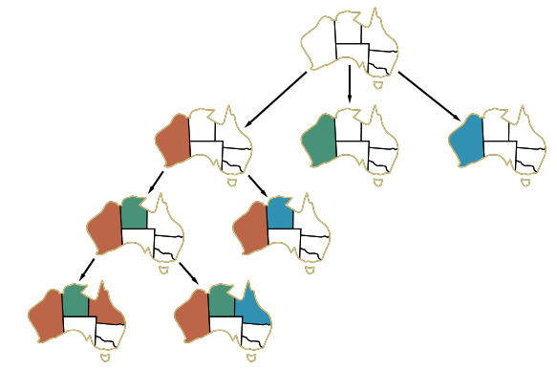
Backtracking Search for CSPs
Branching factor at the top level would be nd
At the next level, the branching factor is (n − 1)d, and so on for n levels.
So the tree has n!· leaves.

Slide 6
Backtracking Search for CSPs
We can get back that factor of n! by recognizing a crucial property of CSPs: commutativity.
A problem is commutative if the order of application of any given set of actions does Commutativity not matter.
In CSPs, it makes no difference if we first assign NSW = red and then SA = blue, or the other way around.
With this restriction, the number of leaves is .

Slide 7
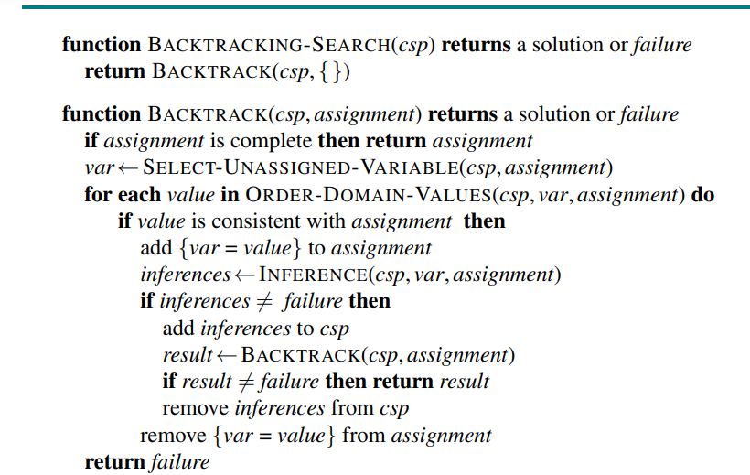
Backtracking Algorithm

Slide 8
Backtracking Algorithm
4-Queens Problem
A | B | C | D

Slide 9
Backtracking Search for CSPs
A | B | C | D
Q1

Slide 10
Backtracking Search for CSPs
A | B | C | D
Q1 | x
 | x
 | Q2

Slide 11
Backtracking Search for CSPs
A | B | C | D
Q1 | x | x
 | x | x
 | Q2 | x
 |  | x

Slide 12
Backtracking Search for CSPs
A | B | C | D
Q1 | x | x
 | x | x
 | Q2 | x
 |  | x

Slide 13
Backtracking Search for CSPs
A | B | C | D
Q1 | x
 | x
 | x
 | Q2

Slide 14
Backtracking Search for CSPs
A | B | C | D
Q1 | x | x
 | x | Q3
 | x
 | Q2

Slide 15
Backtracking Search for CSPs
A | B | C | D
Q1 | x | x | x
 | x | Q3 | x
 | x |  | x
 | Q2 |  | x

Slide 16
Backtracking Search for CSPs
A | B | C | D
Q1 | x | x | x
 | x | Q3 | x
 | x |  | x
 | Q2 |  | x

Slide 17
Backtracking Search for CSPs
A | B | C | D
Q1 | x | x
 | x | x
 | x | x
 | Q2 | x

Slide 18
Backtracking Search for CSPs
A | B | C | D
Q1 | x | x
 | x | x
 | x | x
 | Q2 | x

Slide 19
Backtracking Search for CSPs
A | B | C | D
Q1 | x
 | x
 | x
 | x

Slide 20
Backtracking Search for CSPs
A | B | C | D
x
Q1

Slide 21
Backtracking Search for CSPs
A | B | C | D
x | x
Q1 | x
 | x
 | Q2

Slide 22
Backtracking Search for CSPs
A | B | C | D
x | x | Q3
Q1 | x
 | x
 | Q2

Slide 23
Backtracking Search for CSPs
A | B | C | D
x | x | Q3 | x
Q1 | x |  | x
 | x |  | Q4
 | Q2
Solution:

Slide 24
Backtracking Search for CSPs
Now extend the algorithm for the 8-queens problem.

Slide 25

Variable and value ordering
The simplest strategy for SELECT-UNASSIGNED-VARIABLE is static ordering.
Choose the variables in order or randomly.
Neither strategy is optimal.

Slide 26
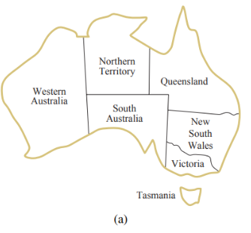
Variable and value ordering: minimum-remaining-values (MRV) heuristic.
This intuitive idea—choosing the variable with the fewest “legal” values—is called the minimum-remaining-values (MRV) heuristic.
It also has been called the “most constrained variable” or “fail-first” heuristic.

Slide 27
Variable and value ordering: degree heuristic
The MRV heuristic doesn’t help at all in choosing the first region to color in Australia map.
In this case, the degree heuristic comes Degree heuristic in handy.
Selecting the variable that is involved in the largest number of constraints on other unassigned variables.
SA is the variable with highest degree, 5

Slide 28
Variable and value ordering: least-constraining-value heuristic
Once a variable has been selected, the algorithm must decide on the order in which to examine its values.
The least-constraining-value heuristic is effective for this.
It prefers the value that rules out the fewest choices for the neighboring variables in the constraint graph.

